Slide 1
GROUP PROGRESSION
*Meeting the listed requirements does not guarantee group placement.
Final decisions are made at the discretion of the coaching staff.
TRACK INFORMATION
SHOW ALL GROUPS
SELECT AGE/TRACK
UPDATED 7/11/25
Notes:
Disabled slide progression on mouse click – will only move to a new slide if a button/link is clicked.
Back button goes to last viewed slide.

Slide 2
TRACKS
DEVELOPMENT
CHALLENGE
ELITE
Swimmers in this track are building strong habits, learning teamwork, and developing a love for the sport. They’re growing as students of swimming while gaining skills that support success in school, other sports, and life – especially goal setting.
Practices range from 3 to 5 times per week, with opportunities to compete and progress to higher-level groups.
Challenge Track athletes are building the skills, mindset, and work ethic needed to excel in swimming. They are in the pool 5-6 times per week plus dryland workouts.
They learn to set goals, train with purpose, and respond to coaching. Athletes/families commit to an 11-month contract with increased attendance, engagement and volunteerism standards.
Athletes in the Elite track train to compete at the state and national level. They are held to a high standard of excellence, commitment, and elite performance.
Athletes are in the pool 6-8 times per week with required dryland workouts. Athletes/families commit to an 11-month contract with elevated expectations for goal setting and accountability.
BACK
GO TO GROUP SELECT

Slide 3



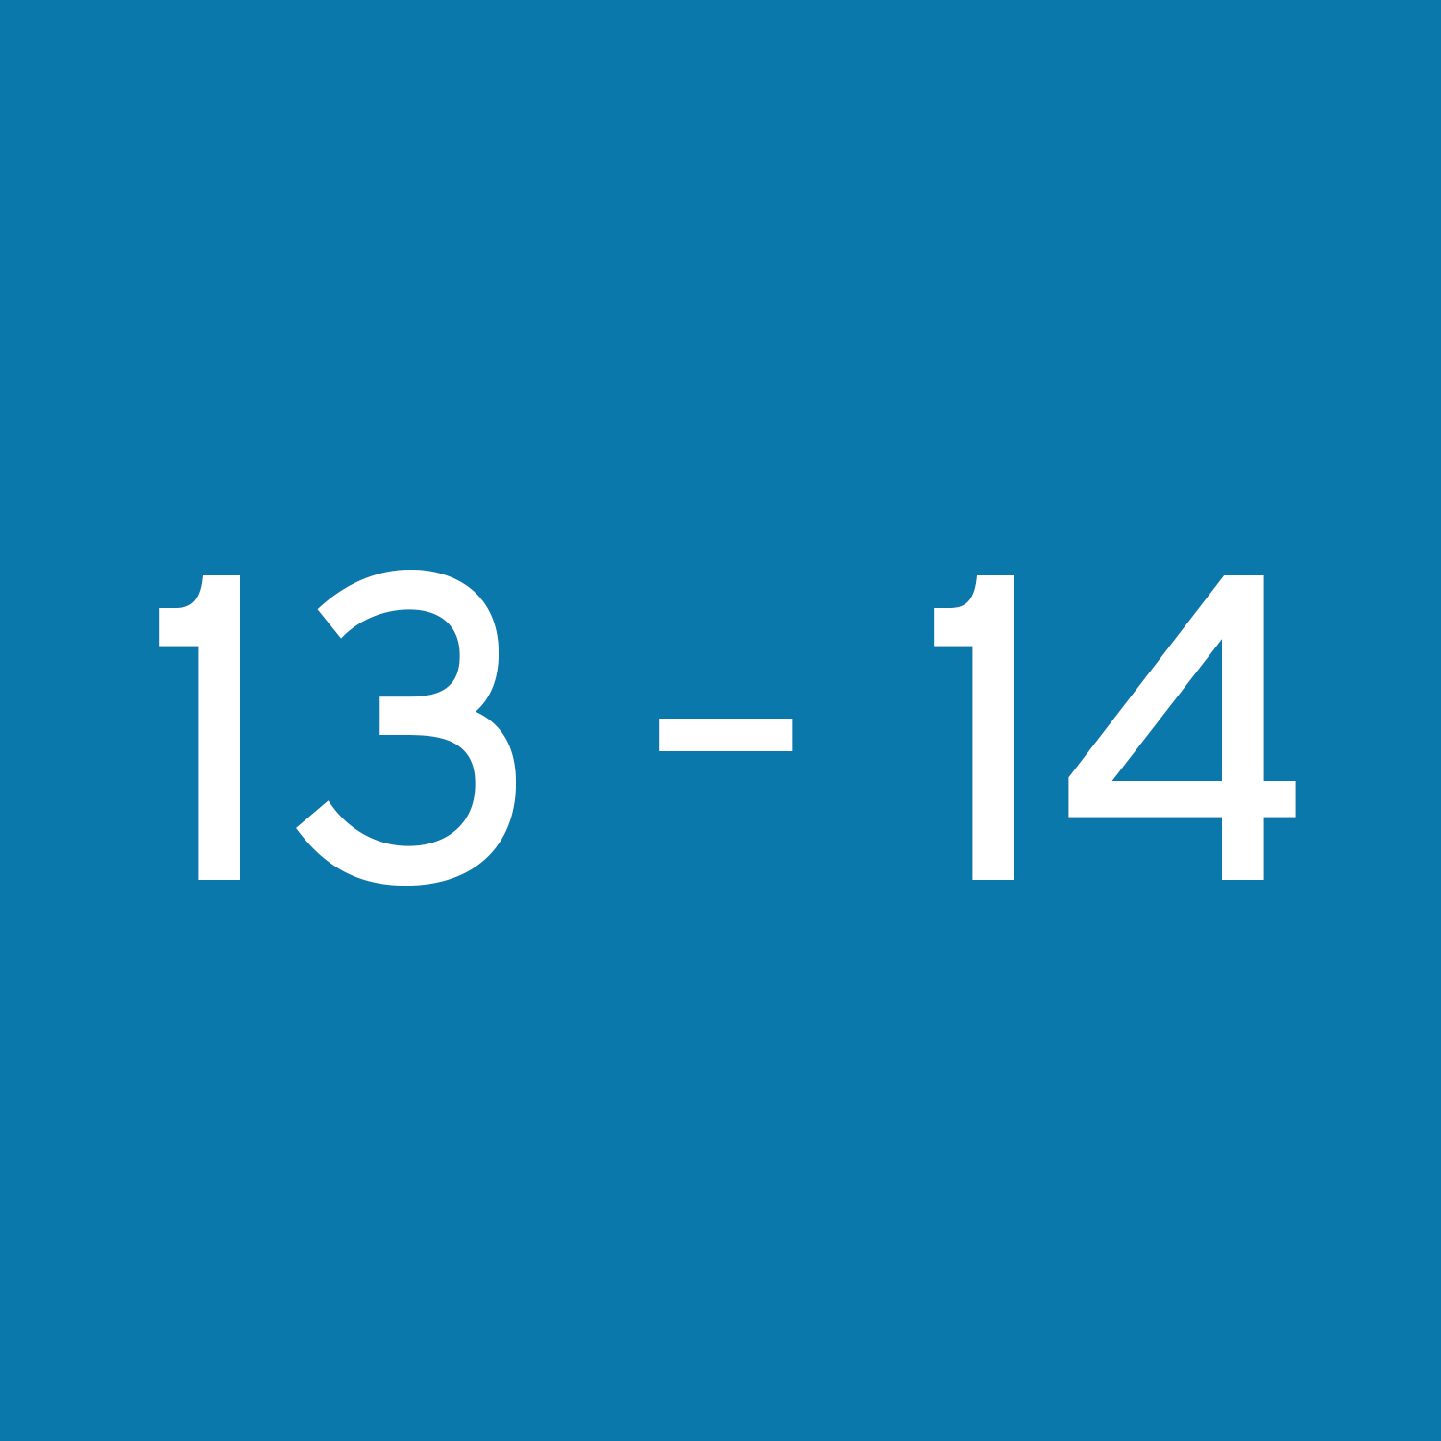



SELECT YOUR AGE GROUP OR TRACK
BACK
SHOW ALL GROUPS
TRACK INFORMATION

Slide 4









SHOW ALL GROUPS
BACK
SELECT AGE/TRACK
10&U
Development Track
Challenge Track
Elite Track
Development Track
Challenge Track
Elite Track

Slide 5





11-12
SHOW ALL GROUPS
BACK
SELECT AGE/TRACK
Development Track
Challenge Track
Elite Track
Development Track
Challenge Track
Elite Track

Slide 6





SHOW ALL GROUPS
BACK
SELECT AGE/TRACK
13-14
Development Track
Challenge Track
Elite Track
Development Track
Challenge Track
Elite Track

Slide 7







SHOW ALL GROUPS
BACK
SELECT AGE/TRACK
15+
Development Track
Challenge Track
Elite Track
Development Track
Challenge Track
Elite Track

Slide 8
DEVELOPMENT TRACK
BACK
SHOW ALL GROUPS
SELECT AGE/TRACK

Slide 9
JR. TITANS 1 (PREP)
Goal: Develop all 4 strokes
Ages: 5-10
Requirements:
Must be able to swim 25 yards of Freestyle and Backstroke
Comfortable in pool over 7 feet deep
Swim evaluation and coach recommendation
NEXT STEPS
BACK
SHOW ALL GROUPS
SELECT AGE/TRACK

Slide 10
JR. TITANS 2
Goal: Develop all 4 strokes
Ages: 8 & Under
Requirements:
Interest in participating in USA Swimming meets
Proficient in 2 strokes, working knowledge of other 2 strokes
Swim evaluation
NEXT STEPS
BACK
SHOW ALL GROUPS
SELECT AGE/TRACK

Slide 11
JR. TITANS 3
Goal: Develop all 4 strokes
Ages: 9-10
Schedule: 3 days/week, 1 hour each
Requirements:
Interest in participating in USA Swimming meets
Proficient in 2 strokes, working knowledge of other 2 strokes
Swim evaluation
NEXT STEPS
BACK
SHOW ALL GROUPS
SELECT AGE/TRACK

Slide 12
JR. TITANS 4
Goal: Develop all 4 strokes
Ages: 11-14
Schedule: 3 days/week, 1 hour each
Requirements:
Interest in participating in USA Swimming meets
Must be able to swim a 50 Freestyle with a workable flip turn, a 50 Backstroke with an idea of how to use the flags, and either a legal 25 Breaststroke or legal 25 Butterfly
Swim evaluation
NEXT STEPS
BACK
SHOW ALL GROUPS
SELECT AGE/TRACK

Slide 13
TEEN TITANS
Goal: High-school swimming
Ages: 13-18
Schedule: 5 days/week, month-to-month commitment level
Requirements:
Interest in participating in USA Swimming meets
Must be able to swim a 50 Freestyle with a workable flip turn, a 50 Backstroke with an idea of how to use the flags, and either a legal 25 Breaststroke or legal 25 Butterfly
Swim evaluation
NEXT STEP
BACK
SHOW ALL GROUPS
SELECT AGE/TRACK

Slide 14
CHALLENGE TRACK
BACK
SHOW ALL GROUPS
SELECT AGE/TRACK

Slide 15
COPPER 2
*All “B”, “BB”, “A”, and “AA” times are based off the 2024-2028 USA Swimming Motivational Time Standards
Goal: Achieve USA Swimming 10&U “B” time standards
Ages: 6-8
Requirements:
Must be able to legally perform all 4 competitive strokes for 50 yards
Recommended:
Prior year-round competitive experience or multiple seasons of summer league
Consistent involvement in competitive swim meets
Other factors: coachability, training engagement, technical proficiency, coach recommendation
NEXT STEPS
BACK
SHOW ALL GROUPS
SELECT AGE/TRACK

Slide 16
COPPER 1
*All “B”, “BB”, “A”, and “AA” times are based off the 2024-2028 USA Swimming Motivational Time Standards
Goal: Achieve USA Swimming 10&U “BB” and “A” time standards
Ages: 7-8
Requirements:
Previous year-round competitive swim experience
Can legally race 50 yards of all 4 strokes, AND 100 yards of Freestyle and Backstroke
Can dive headfirst from starting blocks, legally complete flip turns and open turns
Time Requirements:
Age 7:
50 Butterfly – 1:00
50 Backstroke – :55
50 Breaststroke – 1:00
50 Freestyle – :50
Age 8:
50 Butterfly – :55
50 Backstroke – :50
50 Breaststroke – :55
50 Freestyle – :45
NEXT STEPS
BACK
SHOW ALL GROUPS
SELECT AGE/TRACK

Slide 17
BRONZE
*All “B”, “BB”, “A”, and “AA” times are based off the 2024-2028 USA Swimming Motivational Time Standards
Goal: Take steps into the competitive side of swimming while continuing to develop stroke skills, practice habits, racing habits, and enjoyment of the sport
Ages: 9-10
Recommended:
Prior year-round competitive experience
High practice attendance
Requirements:
Must be able to legally race 50 yards in all 4 strokes
Familiar with flip turns and starts
Achieved at least 1x USA Swimming 10&U “B” time
NEXT STEPS
BACK
SHOW ALL GROUPS
SELECT AGE/TRACK

Slide 18
TITANIUM
*All “B”, “BB”, “A”, and “AA” times are based off the 2024-2028 USA Swimming Motivational Time Standards
Goals: Learn to be great students and teammates while learning the value of process. Work to achieve multiple USA Swimming 10&U “BB” times. Work towards “A” time standards, and 9&10 NCS Age Group Championship qualifying times.
Ages: 9-10
Requirements:
USA Swimming 10&U “B” times in 3 different strokes, AND 1x “B” time standard in either the 100 or 200 IM
70% attendance in previous group, must maintain 70% attendance in Titanium
Legal mechanics in all 4 strokes, and working knowledge of other technical aspects like streamline, underwaters, breathing…
NEXT STEPS
BACK
SHOW ALL GROUPS
SELECT AGE/TRACK

Slide 19
SILVER 2
*All “B”, “BB”, “A”, and “AA” times are based off the 2024-2028 USA Swimming Motivational Time Standards
Goals:
Goal setting, training, and structure of being a competitive year-round swimmer
Prepare for and race the 50 and 100 yd/m of each stroke, and the 200 Free and 200 IM
Ages: 11-12
Requirements:
If coming from 10&U:
2x 10&U “B” times across 2 strokes, AND at least 1x 10&U “B” time in an IM event
If coming from 11&12:
2x 11&12 “B” times across 2 strokes, AND 1x 11&12“B” time in an IM event
NEXT STEPS
BACK
SHOW ALL GROUPS
SELECT AGE/TRACK

Slide 20
SILVER 1
*All “B”, “BB”, “A”, and “AA” times are based off the 2024-2028 USA Swimming Motivational Time Standards
Goal: Achieve USA Swimming 11&12 “A” time standards and qualify for NCS Age Group Championships
Ages: 11-12
Requirements:
If coming from 10&U:
4x 10&U “BB” times in all 100 events, AND 1x 10&U “BB” time in the 200 IM
If coming from 11&12:
4x 11&12 “B” times in all 100 events, AND 1x 11&12 “B” time in the 200 IM
NEXT STEPS
BACK
SHOW ALL GROUPS
SELECT AGE/TRACK

Slide 21
GOLD
*All “B”, “BB”, “A”, and “AA” times are based off the 2024-2028 USA Swimming Motivational Time Standards
Goal: Work towards achieving USA Swimming 13&14 “BB” and “A” time standards
Ages: 13-14
Requirements:
If coming from 11&12:
2x 11&12 “B” times
If coming from 13&14:
2x 13&14 “B” times
NEXT STEPS
BACK
SHOW ALL GROUPS
SELECT AGE/TRACK

Slide 22
PLATINUM
*All “B”, “BB”, “A”, and “AA” times are based off the 2024-2028 USA Swimming Motivational Time Standards
Goals:
Work towards USA Swimming 13&14 “A” and “AA” times
13&14 NCS Age Group Championship time standards
Legally complete at least 1 race in each event offered at senior level
Ages: 13-14
Requirements:
If coming from 11&12:
2x 11&12 “BB” times AND 2x 11&12 “B” times
If coming from 13&14:
4x 13&14 “BB” times
NEXT STEPS
BACK
SHOW ALL GROUPS
SELECT AGE/TRACK

Slide 23
SENIOR CHALLENGE
*All “B”, “BB”, “A”, and “AA” times are based off the 2024-2028 USA Swimming Motivational Time Standards
Goal: Achieve a NCS Senior Championships qualifying time
Ages: 15+
Requirements:
2x USA Swimming 14&O “B” time standards AND 1x USA Swimming 14&O “BB” time standard
OR be recommended by a coach
Must maintain 70% attendance rate
NEXT STEPS
BACK
SHOW ALL GROUPS
SELECT AGE/TRACK

Slide 24
SENIOR CHAMPS B
*All “B”, “BB”, “A”, and “AA” times are based off the 2024-2028 USA Swimming Motivational Time Standards
Goal: Have multiple swims at the NCS Senior Championships meet
Ages: 15+
Requirements:
If coming from 13&14:
1x 13&14 “A” time AND 2x 13&14 “BB” times
If coming from 15&O:
1x 14&O “A” time AND 3x 14&O “BB” times in 2 different strokes
Must maintain 70% attendance rate
NEXT STEPS
BACK
SHOW ALL GROUPS
SELECT AGE/TRACK

Slide 25
SENIOR CHAMPS A
*All “B”, “BB”, “A”, and “AA” times are based off the 2024-2028 USA Swimming Motivational Time Standards
Goals:
Achieve USA Swimming “AA” times
Have multiple swims at the NCS Senior Championships meet
Ages: 15+
Requirements:
If coming from 13&14:
4x 13&14 “A” times in 2 different strokes
If coming from 15&O:
1x 14&O NCS Senior Champs qualifying time AND 1x 14&O “A” time, in 2 different strokes
OR 3x 14&O “A” times in at least 2 different strokes
Must maintain 80% attendance rate
NEXT STEPS
BACK
SHOW ALL GROUPS
SELECT AGE/TRACK

Slide 26
ELITE TRACK
BACK
SHOW ALL GROUPS
SELECT AGE/TRACK

Slide 27
TAG 3.5
*All “B”, “BB”, “A”, and “AA” times are based off the 2024-2028 USA Swimming Motivational Time Standards
Goal: Qualify for and compete at the NCS Age Group Championships
Ages: 9-10
Requirements:
Age 9:
10&U “BB” times in 3 different events
AND 1x 10&U “BB” time in the 200 IM
Age 10:
10&U “BB” times in 4 strokes
AND 1x 10&U “BB” time in the 200 IM
NEXT STEPS
BACK
SHOW ALL GROUPS
SELECT AGE/TRACK

Slide 28
TAG 3
*All “B”, “BB”, “A”, and “AA” times are based off the 2024-2028 USA Swimming Motivational Time Standards
Goal: Compete and score at the NCS Age Group Championships and ESSZ Age Group Sectionals
Ages: 9-10
Requirements:
Age 9:
4x 10&U “A” times
OR 3+ 10&U NCS Age Group Champs qualifying times with 1 being an IM event
Age 10:
4x 10&U NCS Age Group Champs qualifying times AND 1x 10&U “A” time in the 200 Free or 200 IM
NEXT STEPS
BACK
SHOW ALL GROUPS
SELECT AGE/TRACK

Slide 29
TAG 2.5
*All “B”, “BB”, “A”, and “AA” times are based off the 2024-2028 USA Swimming Motivational Time Standards
Goal: Train towards achieving 11&12 NCS Age Group Championships qualifying times
Ages: 11-12
Requirements:
If coming from 10&U:
4x 10&U “A” times AND 1x 10&U “BB” time in the 100 or 200 IM AND achieved cumulative power score of 2500 points combining these events: 100 Free, 100 Back, 100 Breast, 100 Fly, and 200 IM
If coming from 11&12:
4x 11&12 “BB” times AND achieved cumulative power score of 2000 points combining these events: 100 Free, 100 Back, 100 Breast, 100 Fly, and 200 IM
NEXT STEPS
BACK
SHOW ALL GROUPS
SELECT AGE/TRACK

Slide 30
TAG 2
*All “B”, “BB”, “A”, and “AA” times are based off the 2024-2028 USA Swimming Motivational Time Standards
Goals:
Compete at highest level at NCS Age Group Champs and ESSZ Age Group Sectionals
Embrace the technical, physical, and mental facets of competitive swimming
Ages: 11-12
Requirements:
If coming from 10&U:
6x 10&U “AA” times AND 1x 10&U “A” time in the 100 or 200 IM AND achieved cumulative power score of 3000 points combining these 5 events: 100 Free, 100 Back, 100 Breast, 100 Fly, and 200 IM
If coming from 11&12:
6x 11&12 “BB” times AND 2x 11&12 “A” times, including 1x NCS Age Group Champs qualifying time AND achieved a cumulative power score of 2500 points combining these 5 events: 100 Free, 100 Back, 100 Breast, 100 Fly, and 200 IM
NEXT STEPS
BACK
SHOW ALL GROUPS
SELECT AGE/TRACK

Slide 31
TAG 1.5
*All “B”, “BB”, “A”, and “AA” times are based off the 2024-2028 USA Swimming Motivational Time Standards
Goal: Achieve multiple 13&14 NCS Age Group Champs qualifying times
Ages: 13-14
Requirements:
Girls:
4x 13&14 “A” times
Boys:
4x 13&14 “BB” times AND 1x 13&14 “A” time
All must maintain at least 80% attendance rate
NEXT STEPS
BACK
SHOW ALL GROUPS
SELECT AGE/TRACK

Slide 32
TAG 1
*All “B”, “BB”, “A”, and “AA” times are based off the 2024-2028 USA Swimming Motivational Time Standards
Goal: Final at NCS Age Group Champs and ESSZ Age Group Sectionals
Ages: 13-14
Requirements:
Girls:
5x 13&14 “AA” times, with 2x 13&14 NCS Age Group Champs qualifying times in 2 different strokes
Boys:
5x 13&14 “A” times, with 2x 13&14 NCS Age Group Champs qualifying times in 2 different strokes
All must maintain at least 80% attendance rate
NEXT STEPS
BACK
SHOW ALL GROUPS
SELECT AGE/TRACK

Slide 33
SECTIONAL
Goals: Final at NCS Senior Champs or our respective “Primary” competition; increase swimmers’ versatility
Ages: 15+
Requirements:
4x NCS Senior Champs qualifying times
OR 3x qualifying times separated as – 2x NCS Senior Champs and 1x ESSZ Senior Sectional qualifying times
NEXT STEPS
BACK
SHOW ALL GROUPS
SELECT AGE/TRACK

Slide 34
NATIONAL
Goal: Work towards scoring at the ESSZ Senior Sectional and Futures Championships meets
Ages: 15+
Requirements:
3x ESSZ Senior Sectional qualifying times in 2 different disciplines (strokes, IM, 200 Free and down, 500/400 Free and up)
OR 1x Futures Championships qualifying time
Must maintain at least 85% attendance rate
NEXT STEPS
BACK
SHOW ALL GROUPS
SELECT AGE/TRACK

Slide 35
FUTURES
Goals:
Work towards competing at the highest level at the USA Swimming Futures Championships
Achieve Junior National qualifying times
Embrace a culture of consistency and high standards to which one trains and competes
Ages: 15+
Requirements:
If coming from 13&14:
1x Futures Champs qualifying time
OR 6x 13&14 ESSZ Sectional qualifying times
If coming from 15&O:
1x Futures Champs qualifying time AND achieve the following time standard in either the 200 IM or 400 IM:
Women (yd/m):
200 IM – 2:14.4 / 2:33.2
400 IM – 4:44.1 / 5:22.8
Men (yd/m):
200 IM – 2:02.6 / 2:22.6
400 IM – 4:24.3 / 5:03.7
NEXT STEPS
BACK
SHOW ALL GROUPS
SELECT AGE/TRACK

Slide 36
OLYMPIC ELITE
Goal: Olympic Trial or US Open qualification
Ages: 15+
Requirements:
Girls – 1x USA Swimming Winter Junior National qualifying time
Women with 5x Futures Champs qualifying times will be considered.
Boys – 1x USA Swimming Winter Junior National qualifying time
Men with 4x Futures Champs qualifying times will be considered.
BACK
SHOW ALL GROUPS
SELECT AGE/TRACK

Slide 37
ALL GROUPS
BACK
ELITE
CHALLENGE
DEVELOPMENT

